Slide 1
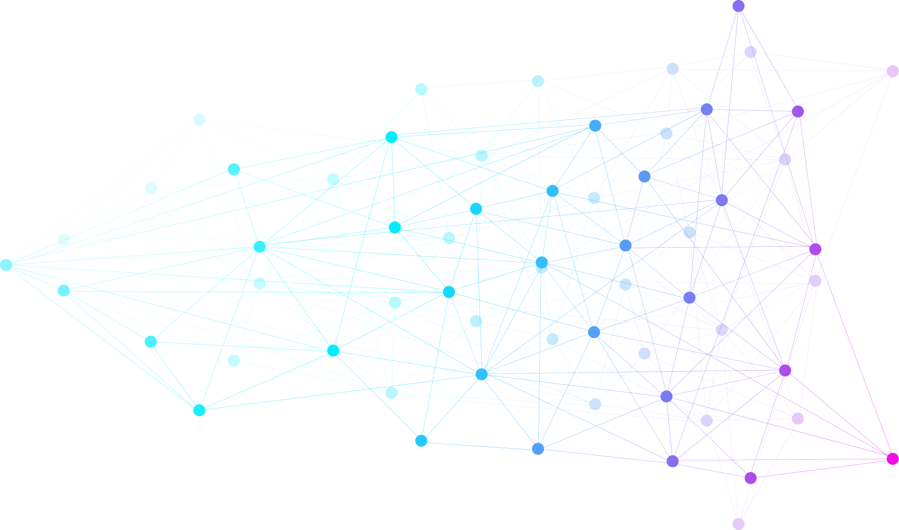

2026 IEEE International
Conference on Integrated Circuits,
Technologies & Applications
21st - 24th OCT
Grand Copthorne Waterfront Hotel

